Slide 1
Recurrent Neural Networks
Basic and Implementations
전태균
2016.10.05
2016 한국 슈퍼컴퓨팅 컨퍼런스 (KSC 2016)

Slide 2
What you will learn about RNN
What is Recurrent Neural Networks?
How to build a RNN model?
Manipulate time series data
For RNN models
Run and evaluate graph
Predict using RNN as regression model

Slide 3
Contents
Overview of TensorFlow
Recurrent Neural Networks (RNN)
RNN Implementation
Case studies
Case study #1: MNIST using RNN
Case study #2: sine function
Case study #3: electricity price forecasting
Conclusions
Q & A

Slide 4

Contents
Overview of TensorFlow
Recurrent Neural Networks (RNN)
RNN Implementation
Case studies
Case study #1: MNIST using RNN
Case study #2: sine function
Case study #3: electricity price forecasting
Conclusions
Q & A

Slide 5
TensorFlow
Open Source Software Library for Machine Intelligence

Slide 6
Prerequisite
Software
TensorFlow (r0.10)
Python (2.7.6)
Numpy (1.11.1)
Pandas (0.18.1)
Tutorials
“Recurrent Neural Networks”, TensorFlow Tutorials
“Sequence-to-Sequence Models”, TensorFlow Tutorials
Blog Posts
Understanding LSTM Networks (Chris Olah @ colah.github.io)
Introduction to Recurrent Networks in TensorFlow (Danijar Hafner @ danijar.com)
Book
“Deep Learning”, I. Goodfellow, Y. Bengio, and A. Courville, MIT Press, 2016

Slide 7
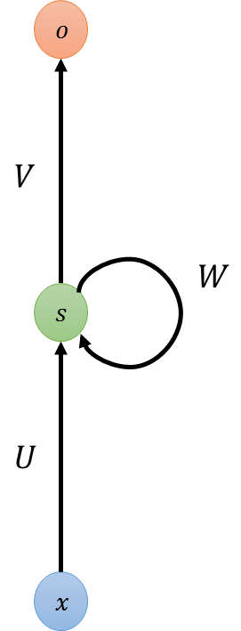
Contents
Overview of TensorFlow
Recurrent Neural Networks (RNN)
RNN Implementation
Case studies
Case study #1: MNIST using RNN
Case study #2: sine function
Case study #3: electricity price forecasting
Conclusions
Q & A

Slide 8

















Recurrent Neural Networks
Neural Networks
Inputs and outputs are independent
Recurrent Neural Networks
Sequential inputs and outputs
$$o$$
$$o$$
$$o$$
$$o_{t−1}$$
$$o_{t}$$
$$o_{t+1}$$
...
...
$$s$$
$$s$$
$$s$$
$$s$$
$$s$$
$$s$$
$$s$$
$$s$$
$$x$$
$$x$$
$$x$$
$$x_{t−1}$$
$$x_{t}$$
$$x_{t+1}$$

Slide 9
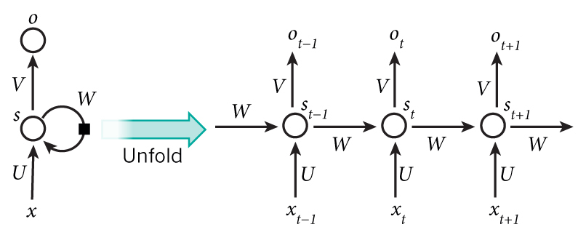

Recurrent Neural Networks (RNN)
$x_{t}:$ the input at time step $t$
$s_{t}$: the hidden state at time $t$
$o_{t}$: the output state at time $t$
Image from WILDML.com: “RECURRENT NEURAL NETWORKS TUTORIAL, PART 1 – INTRODUCTION TO RNNS”

Slide 10

Overall procedure: RNN
Initialization
All zeros
Random values (dependent on activation function)
Xavier initialization ^{[1]}: Random values in the interval from $\left[−\frac{1}{\sqrt{n}},\frac{1}{\sqrt{n}}\right],$ where n is the number of incoming connections
from the previous layer
X. Glorot and Y. Bengio, “Understanding the difficulty of training deep feedforward neural networks” (2010)

Slide 11

Overall procedure: RNN
Initialization
Forward Propagation
$s_{t}=f\left(Ux_{t}+Ws_{t−1}\right)$
$s_{t}:$ new state
$s_{t−1}$: old state
$x_{t}$: input vector at some time step
Function $f$ usually is a nonlinearity such as tanh or ReLU
$o_{t}=softmax\left(Vs_{t}\right)$

Slide 12

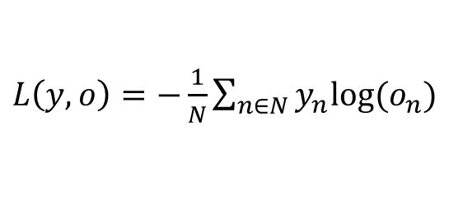
Overall procedure: RNN
Initialization
Forward Propagation
Calculating the loss
$y:$ the labeled data
$o:$ the output data
Cross-entropy loss:
$L\left(y,o\right)=−\frac{1}{N}\sum_{n∈N}{y_{n}log⁡(o_{n})}$

Slide 13

Overall procedure: RNN
Initialization
Forward Propagation
Calculating the loss
Stochastic Gradient Descent (SGD)
Push the parameters into a direction that reduced the error
The directions: the gradients on the loss
: $\frac{∂L}{∂U},\frac{∂L}{∂V},\frac{∂L}{∂W}$

Slide 14
Overall procedure: RNN
Initialization
Forward Propagation
Calculating the loss
Stochastic Gradient Descent (SGD)
Backpropagation Through Time (BPTT)
Long-term dependencies
→ vanishing/exploding gradient problem
Backpropagation
Backpropagation
Through Time (BPTT)

Slide 15
Vanishing gradient over time
Standard RNN with sigmoid
The sensitivity of the input values decays over time
The network forgets the previous input
Long-Short Term Memory (LSTM) ^{[2]}
The cell remember the input as long as it wants
The output can be used anytime it wants
A. Graves. “Supervised Sequence Labelling with Recurrent Neural Networks” (2012)

Slide 16
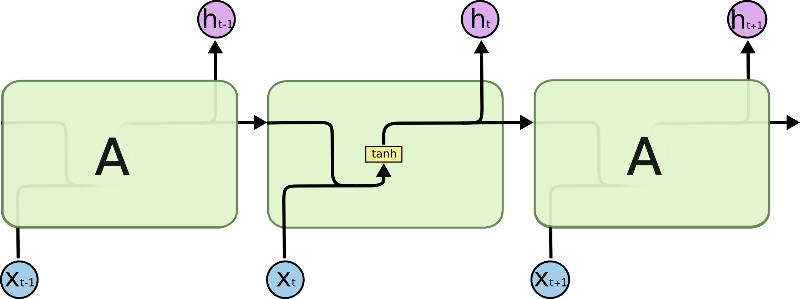
Standard RNN
Simple tanh layer
Blog post by C. Olah. “Understanding LSTM Networks” (2015)

Slide 17

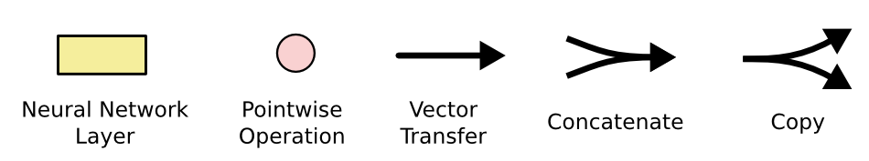
Long Short-Term Memory (LSTM)

Slide 18
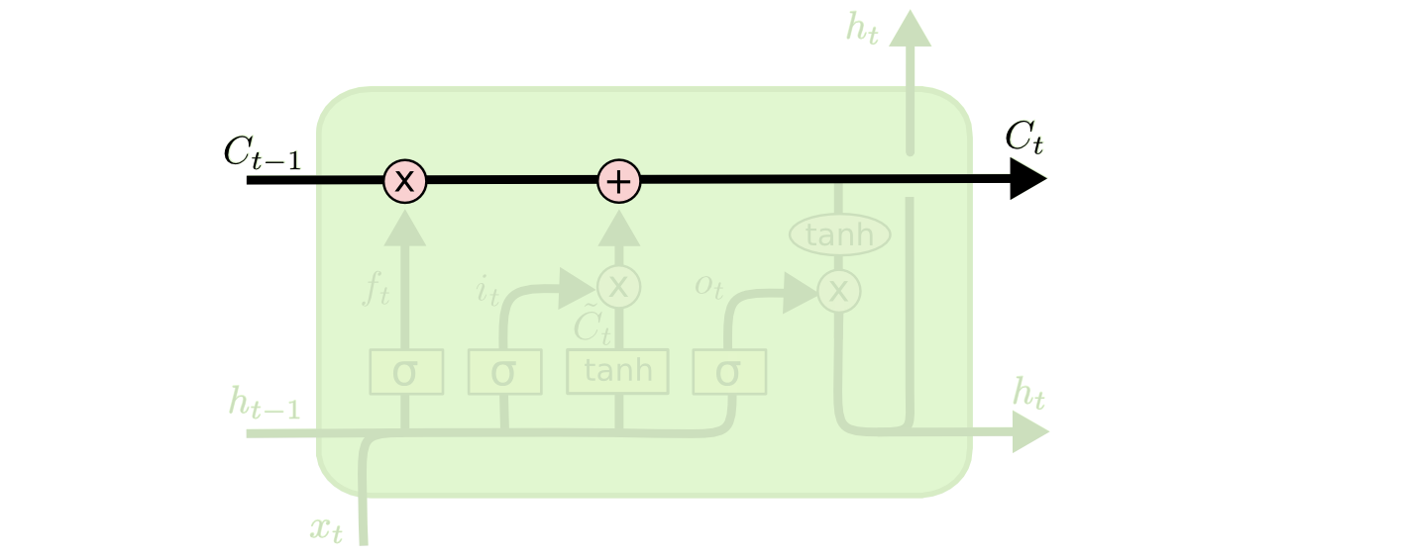
Long Short-Term Memory (LSTM)
Cell state = conveyor belt!
Forget
Input
Update
Output

Slide 19
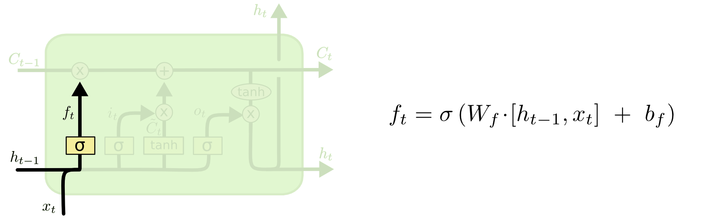
Long Short-Term Memory (LSTM)
Forget gate
LSTM have the ability to remove or add information to the cell state, carefully regulated by structures call gates.
The decision what information we’re going to throw away from the cell state is made by a sigmoid layer “forget gate layer”

Slide 20
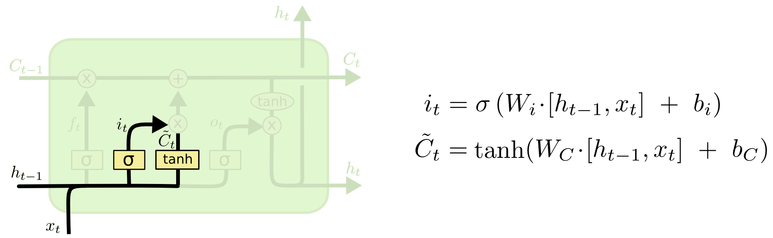
Long Short-Term Memory (LSTM)
Input gate
Decide what new information we’re going to store in the cell state
First, “input gate layer” decide which values we’ll update
Next, “tanh layer” creates a vector of new candidate values
Finally, combine two to create an update to the state

Slide 21
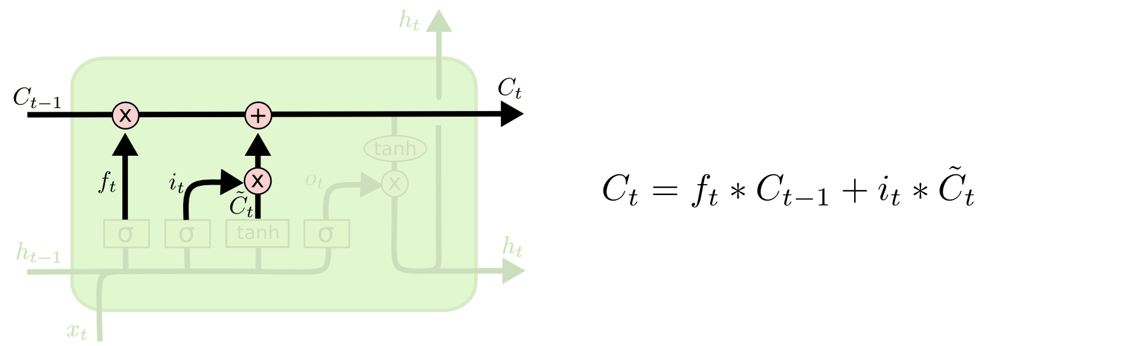
Long Short-Term Memory (LSTM)
Update
This is where we’d actually drop the information about the old subject’s gender and add the new information, as we decided in the previous steps.
Forget old thing
Add new thing

Slide 22
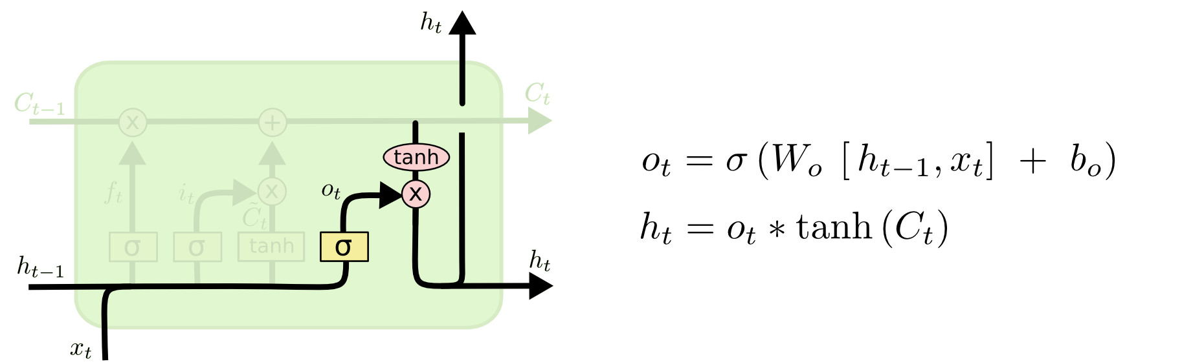
Long Short-Term Memory (LSTM)
Output
Output will be based on cell state.

Slide 23
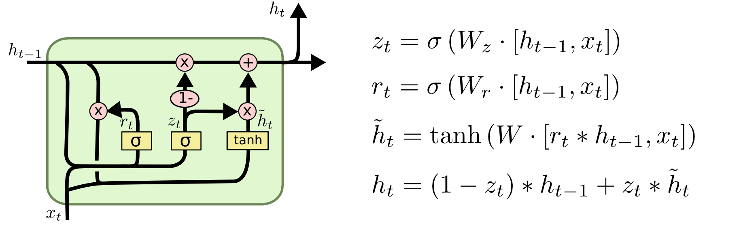
Gated Recurrent Unit (GRU)
Combine the forget and input gates into a single “update gate”
Merge the cell state and hidden state

Slide 24
LSTM vs GRU

Slide 25
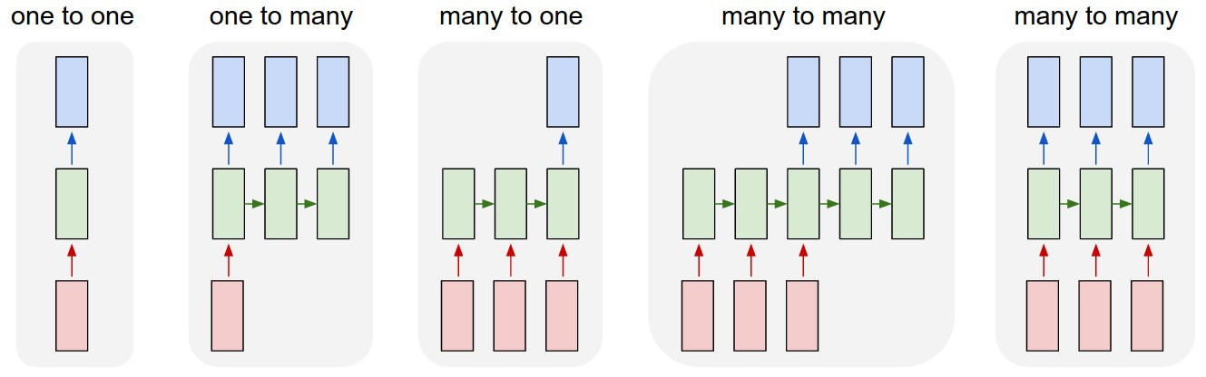
Design Patterns for RNN
RNN Sequences
Task | Input | Output
Image classification | fixed-sized image | fixed-sized class
Image captioning | image input | sentence of words
Sentiment analysis | sentence | positive or negative sentiment
Machine translation | sentence in English | sentence in French
Video classification | video sequence | label each frame
Blog post by A. Karpathy. “The Unreasonable Effectiveness of Recurrent Neural Networks” (2015)

Slide 26
Contents
Overview of TensorFlow
Recurrent Neural Networks (RNN)
RNN Implementation
Case studies
Case study #1: MNIST using RNN
Case study #2: sine function
Case study #3: electricity price forecasting
Conclusions
Q & A

Slide 27
RNN Implementation
Recurrent States
Choose RNN cell type
Use multiple RNN cells
Input layer
Prepare time series data as RNN input
Data splitting
Connect input and recurrent layers
Output layer
Add DNN layer
Add regression model
Create RNN model for regression
Train & Prediction

Slide 28
1) Choose the RNN cell type
Neural Network RNN Cells (tf.nn.rnn_cell)
BasicRNNCell (tf.nn.rnn_cell.BasicRNNCell)
activation : tanh()
num_units : The number of units in the RNN cell
BasicLSTMCell (tf.nn.rnn_cell.BasicLSTMCell)
The implementation is based on RNN Regularization^{[3]}
activation : tanh()
state_is_tuple : 2-tuples of the accepted and returned states
GRUCell (tf.nn.rnn_cell.GRUCell)
Gated Recurrent Unit cell^{[4]}
activation : tanh()
LSTMCell (tf.nn.rnn_cell.LSTMCell)
use_peepholes (bool) : diagonal/peephole connections^{[5]}.
cell_clip (float) : the cell state is clipped by this value prior to the cell output activation.
num_proj (int): The output dimensionality for the projection matrices
W. Zaremba, L. Sutskever, and O. Vinyals, “Recurrent Neural Network Regularization” (2014)
K. Cho et al., “Learning Phrase Representations using RNN Encoder-Decoder for Statistical Machine Translation” (2014)
H. Sak et al., “Long short-term memory recurrent neural network architectures for large scale acoustic modeling” (2014)

Slide 29
LAB-1) Choose the RNN Cell type
Import tensorflow as tf
num_units = 100
rnn_cell = tf.nn.rnn_cell.BasicRNNCell(num_units)
rnn_cell = tf.nn.rnn_cell.BasicLSTMCell(num_units)
rnn_cell = tf.nn.rnn_cell.GRUCell(num_units)
rnn_cell = tf.nn.rnn_cell.LSTMCell(num_units)
BasicRNNCell
BasicLSTMCell
GRUCell
LSTMCell

Slide 30
2) Use the multiple RNN cells
RNN Cell wrapper (tf.nn.rnn_cell.MultiRNNCell)
Create a RNN cell composed sequentially of a number of RNN Cells.
RNN Dropout (tf.nn.rnn_cell.Dropoutwrapper)
Add dropout to inputs and outputs of the given cell.
RNN Embedding wrapper (tf.nn.rnn_cell.EmbeddingWrapper)
Add input embedding to the given cell.
Ex) word2vec, GloVe
RNN Input Projection wrapper (tf.nn.rnn_cell.InputProjectionWrapper)
Add input projection to the given cell.
RNN Output Projection wrapper (tf.nn.rnn_cell.OutputProjectionWrapper)
Add output projection to the given cell.

Slide 31
LAB-2) Use the multiple RNN cells
rnn_cell = tf.nn.rnn_cell.DropoutWrapper (rnn_cell, input_keep_prob=0.8, output_keep_prob=0.8)
output_keep_prob=0.8
GRU/LSTM
Input_keep_prob=0.8
Stacked_lstm = tf.nn.rnn_cell.MultiRNNCell([rnn_cell] * depth)
GRU/LSTM
GRU/LSTM
depth
GRU/LSTM

Slide 32
3) Prepare the time series data
Split raw data into train, validation, and test dataset
split_data ^{[6]}
data : raw data
val_size : the ratio of validation set (ex. val_size=0.2)
test_size : the ratio of test set (ex. test_size=0.2)
def split_data(data, val_size=0.2, test_size=0.2):
ntest = int(round(len(data) * (1 - test_size)))
nval = int(round(len(data.iloc[:ntest]) * (1 - val_size)))
df_train, df_val, df_test = data.iloc[:nval], data.iloc[nval:ntest],
data.iloc[ntest:]
return df_train, df_val, df_test
M. Mourafiq, “tensorflow-lstm-regression” (code: https://github.com/mouradmourafiq/tensorflow-lstm-regression)

Slide 33
LAB-3) Prepare the time series data
train, val, test = split_data(raw_data, val_size=0.2, test_size=0.2)
Raw data
(100%)
Train
(80%)
Test
(20%)
Train
(80%)
Validation
(20%)
Test
(20%)
64%
16%
20%

Slide 34
3) Prepare the time series data
Generate sequence pair (x, y)
rnn_data ^{[6]}
labels : True for input data (x) / False for target data (y)
num_split : time_steps
data : our data
def rnn_data(data, time_steps, labels=False):
"""
creates new data frame based on previous observation
* example:
l = [1, 2, 3, 4, 5]
time_steps = 2
-> labels == False [[1, 2], [2, 3], [3, 4]]
-> labels == True [3, 4, 5]
"""
rnn_df = []
for i in range(len(data) - time_steps):
if labels:
try:
rnn_df.append(data.iloc[i + time_steps].as_matrix())
except AttributeError:
rnn_df.append(data.iloc[i + time_steps])
else:
data_ = data.iloc[i: i + time_steps].as_matrix()
rnn_df.append(data_ if len(data_.shape) > 1 else [[i] for i in data_])
return np.array(rnn_df)

Slide 35
LAB-3) Prepare the time series data
time_steps = 10
train_x = rnn_data(df_train, time_steps, labels=false)
train_y = rnn_data(df_train, time_steps, labels=true)
df_train [1:10000]
train_x
x #01
[1, 2, 3, …,10]
x #02
[2, 3, 4, …,11]
…
x #9990
[9990, 9991, 9992, …,9999]
train_y
y #01
11
y #02
12
…
y #9990
10000

Slide 36
4) Split our data
Split time series data into smaller tensors
split (tf.split)
split_dim : batch_size
num_split : time_steps
value : our data
split_squeeze (tf.contrib.learn.ops.split_squeeze)
Splits input on given dimension and then squeezes that dimension.
dim
num_split
tensor_in
From 0.10rc,
tf:split_squeeze is deprecated and will be removed after 2016-08-01. Use tf.unpack instead.

Slide 37





LAB-4) Split our data
time_step = 10
x_split = split_squeeze(1, time_steps, x_data)
x #01
[1, 2, 3, …,10]
split_squeeze
1
2
3
…
10
$$x_{t−9}$$
$$x_{t−8}$$
$$x_{t−7}$$
$$…$$
$$x_{t}$$

Slide 38
5) Connect input and recurrent layers
Create a recurrent neural network specified by RNNCell
rnn (tf.nn.rnn)
Args:
cell : an instance of RNNCell
inputs : list of inputs, tensor shape = [batch_size, input_size]
Returns:
(outputs, state)
outputs : list of outputs
state : the final state
dynamic_rnn (tf.nn.dynamic_rnn)
Args:
cell : an instance of RNNCell
inputs : list of inputs, tensor shape = [batch_size, input_size]
Returns:
(outputs, state)
outputs : the RNN output
state : the final state

Slide 39






LAB-5) Connect input and recurrent layers
rnn_cell = tf.nn.rnn_cell.BasicLSTMCell(num_units)
stacked_lstm = tf.nn.rnn_cell.MultiRNNCell([rnn_cell] * depth)
x_split = tf.split(batch_size, time_steps, x_data)
output, state = tf.nn.rnn(stacked_lstm, x_split)
$$o_{t−9}$$
$$o_{t−8}$$
$$o_{t−7}$$
$$…$$
$$o_{t}$$
LSTM
LSTM
LSTM
LSTM
LSTM
LSTM
LSTM
$$…$$
LSTM
LSTM
LSTM
LSTM
LSTM
$$x_{t−9}$$
$$x_{t−8}$$
$$x_{t−7}$$
$$…$$
$$x_{t}$$

Slide 40
6) Output Layer
Add DNN layer
dnn (tf.contrib.learn.ops.dnn)
input_layer
hidden units
Add Linear Regression
linear_regression (tf.contrib.learn.models.linear_regression)
X
y

Slide 41
LAB-6) Output Layer
dnn_output = dnn(rnn_output, [10, 10])
LSTM_Regressor = linear_regression(dnn_output, y)
Linear regression
DNN Layer 2 with 10 hidden units
DNN Layer 1 with 10 hidden units
LSTM
LSTM
LSTM
$$…$$
LSTM

Slide 42
7) Create RNN model for regression
TensorFlowEstimator (tf.contrib.learn.TensorFlowEstimator)
regressor =
learn.TensorFlowEstimator(model_fn=LSTM_Regressor,
n_classes=0, verbose=1, steps=TRAINING_STEPS, optimizer='Adagrad',
learning_rate=0.03, batch_size=BATCH_SIZE)
regressor.fit(X['train'], y['train']
predicted = regressor.predict(X['test'])
mse = mean_squared_error(y['test'], predicted)

Slide 43
Contents
Overview of TensorFlow
Recurrent Neural Networks (RNN)
RNN Implementation
Case studies
Case study #1: MNIST using RNN
Case study #2: sine function
Case study #3: electricity price forecasting
Conclusions
Q & A

Slide 44
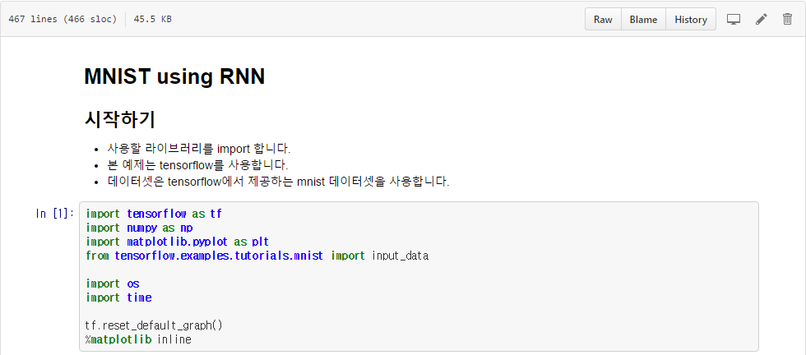
MNIST using RNN
https://github.com/tgjeon/TensorFlow-Tutorials-for-Time-Series/blob/master/mnist-rnn.ipynb

Slide 45
Contents
Overview of TensorFlow
Recurrent Neural Networks (RNN)
RNN Implementation
Case studies
Case study #1: MNIST using RNN
Case study #2: sine function
Case study #3: electricity price forecasting
Conclusions
Q & A

Slide 46
Case study #1: sine function
%matplotlib inline
import numpy as np
from matplotlib import pyplot as plt
from tensorflow.contrib import learn
from sklearn.metrics import mean_squared_error, mean_absolute_error
from lstm_predictor import generate_data, lstm_model
Libraries
numpy: package for scientific computing
matplotlib: 2D plotting library
tensorflow: open source software library for machine intelligence
learn: Simplified interface for TensorFlow (mimicking Scikit Learn) for Deep Learning
mse: "mean squared error" as evaluation metric
lstm_predictor: our lstm class

Slide 47
Case study #1: sine function
LOG_DIR = './ops_logs'
TIMESTEPS = 5
RNN_LAYERS = [{'steps': TIMESTEPS}]
DENSE_LAYERS = [10, 10]
TRAINING_STEPS = 100000
BATCH_SIZE = 100
PRINT_STEPS = TRAINING_STEPS / 100
Parameter definitions
LOG_DIR: log file
TIMESTEPS: RNN time steps
RNN_LAYERS: RNN layer information
DENSE_LAYERS: Size of DNN[10, 10]: Two dense layer with 10 hidden units
TRAINING_STEPS
BATCH_SIZE
PRINT_STEPS

Slide 48
Case study #1: sine function
X, y = generate_data(np.sin, np.linspace(0, 100, 10000), TIMESTEPS, seperate=False)
Generate waveform
fct: function
x: observation
time_steps: timesteps
seperate: check multimodality

Slide 49
Case study #1: sine function
regressor = learn.TensorFlowEstimator(model_fn=lstm_model(TIMESTEPS, RNN_LAYERS, DENSE_LAYERS), n_classes=0, verbose=1, steps=TRAINING_STEPS, optimizer='Adagrad', learning_rate=0.03, batch_size=BATCH_SIZE)
Create a regressor with TF Learn
model_fn: regression model
n_classes: 0 for regression
verbose:
steps: training steps
optimizer: ("SGD", "Adam", "Adagrad")
learning_rate
batch_size

Slide 50
Case study #1: sine function
validation_monitor = learn.monitors.ValidationMonitor(
X['val'], y['val'], every_n_steps=PRINT_STEPS,
early_stopping_rounds=1000)
regressor.fit(X['train'], y['train'], monitors=[validation_monitor], logdir=LOG_DIR)
predicted = regressor.predict(X['test'])
mse = mean_squared_error(y['test'], predicted)
print ("Error: %f" % mse)
Error: 0.000294

Slide 51
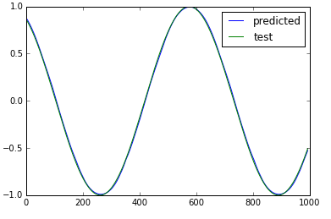
Case study #1: sine function
plot_predicted, = plt.plot(predicted, label='predicted')
plot_test, = plt.plot(y['test'], label='test')
plt.legend(handles=[plot_predicted, plot_test])

Slide 52
Contents
Overview of TensorFlow
Recurrent Neural Networks (RNN)
RNN Implementation
Case studies
Case study #1: MNIST using RNN
Case study #2: sine function
Case study #3: electricity price forecasting
Conclusions
Q & A

Slide 53
Energy forecasting problems
Energy signal (e.g. load, price, generation)
Current time
Signal forecast
External signal (e.g. Weather)
External forecast (e.g. Weather forecast)

Slide 54
Dataset: Historical Data (2015-16) – Prices
Prices ( € / MWh )
Hourly real electricity price for MIBEL (the Portuguese (PT) area)
Duration: Jan 1st, 2015 (UTC 00:00) – Feb 2nd, 2016 (UTC 23:00)

Slide 55
Dataset: Historical Data (2015-16) – Prices
date | (UTC) | Price
01/01/2015 | 0:00 | 48.1
01/01/2015 | 1:00 | 47.33
01/01/2015 | 2:00 | 42.27
01/01/2015 | 3:00 | 38.41
01/01/2015 | 4:00 | 35.72
01/01/2015 | 5:00 | 35.13
01/01/2015 | 6:00 | 36.22
01/01/2015 | 7:00 | 32.4
01/01/2015 | 8:00 | 36.6
01/01/2015 | 9:00 | 43.1
01/01/2015 | 10:00 | 45.14
01/01/2015 | 11:00 | 45.14
01/01/2015 | 12:00 | 47.35
01/01/2015 | 13:00 | 47.35
01/01/2015 | 14:00 | 43.61
01/01/2015 | 15:00 | 44.91
01/01/2015 | 16:00 | 48.1
01/01/2015 | 17:00 | 58.02
01/01/2015 | 18:00 | 61.01
01/01/2015 | 19:00 | 62.69
01/01/2015 | 20:00 | 60.41
01/01/2015 | 21:00 | 58.15
01/01/2015 | 22:00 | 53.6
01/01/2015 | 23:00 | 47.34

Slide 56
Case study #2: Electricity Price Forecasting
dateparse = lambda dates: pd.datetime.strptime(dates, '%d/%m/%Y %H:%M')
rawdata = pd.read_csv("./input/ElectricityPrice/RealMarketPriceDataPT.csv",
parse_dates={'timeline': ['date', '(UTC)']},
index_col='timeline', date_parser=dateparse)
X, y = load_csvdata(rawdata, TIMESTEPS, seperate=False)

Slide 57
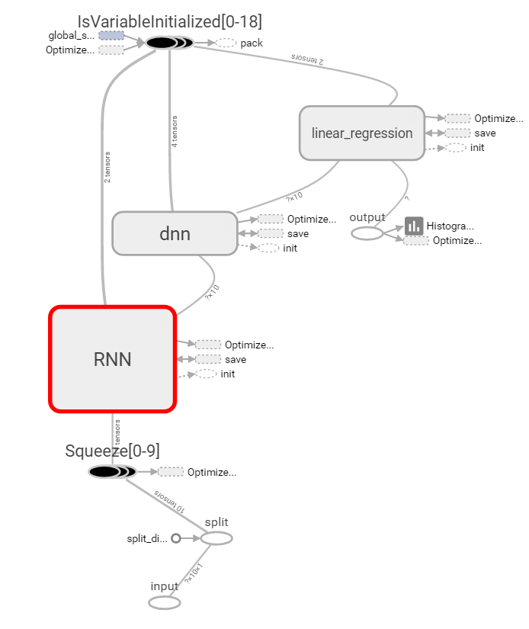
Tensorboard: Main Graph

Slide 58
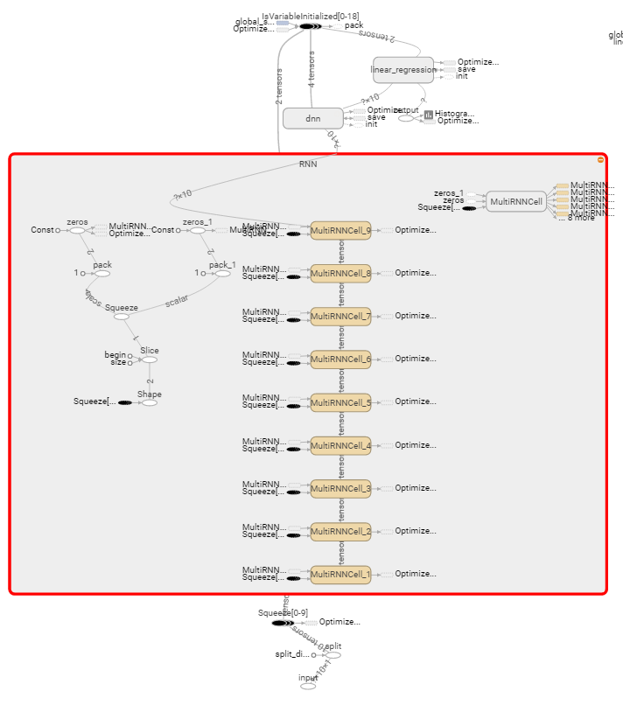
Tensorboard: RNN

Slide 59
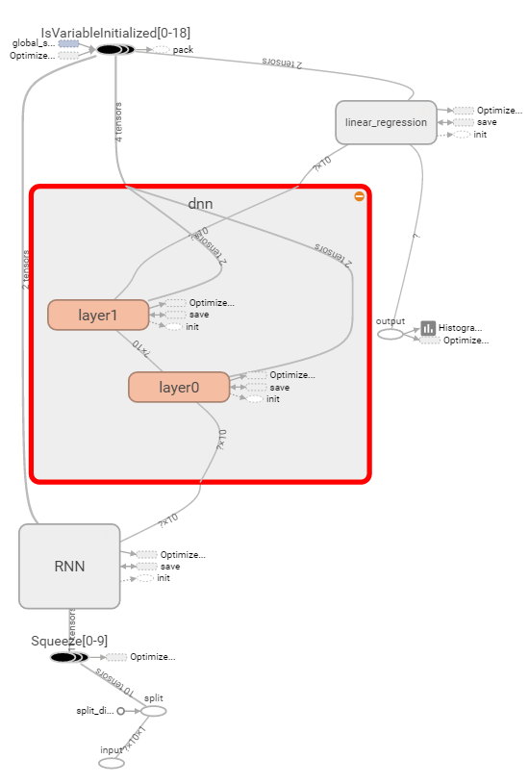
Tensorboard: DNN

Slide 60
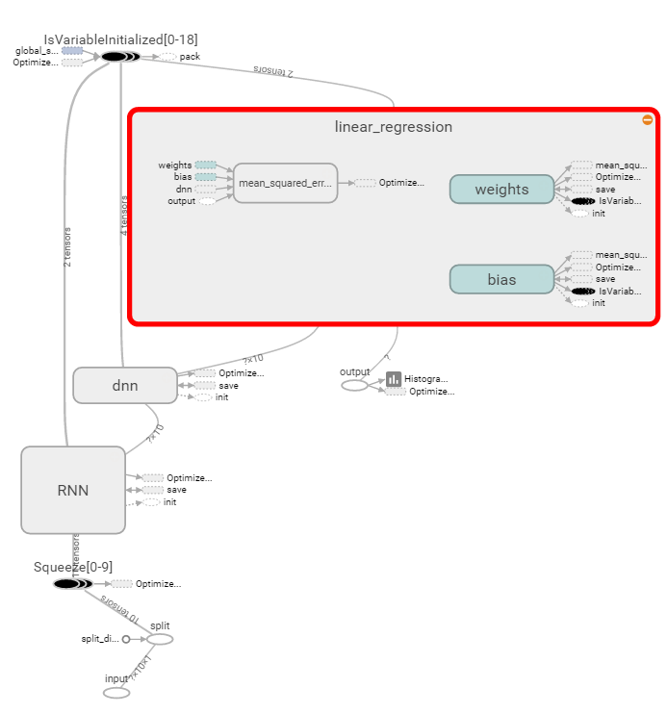
Tensorboard: Linear Regression

Slide 61
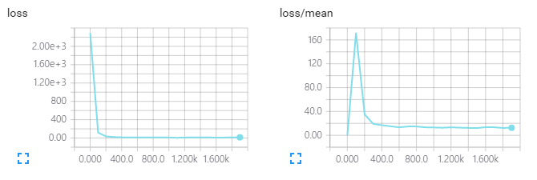
Tensorboard: loss

Slide 62
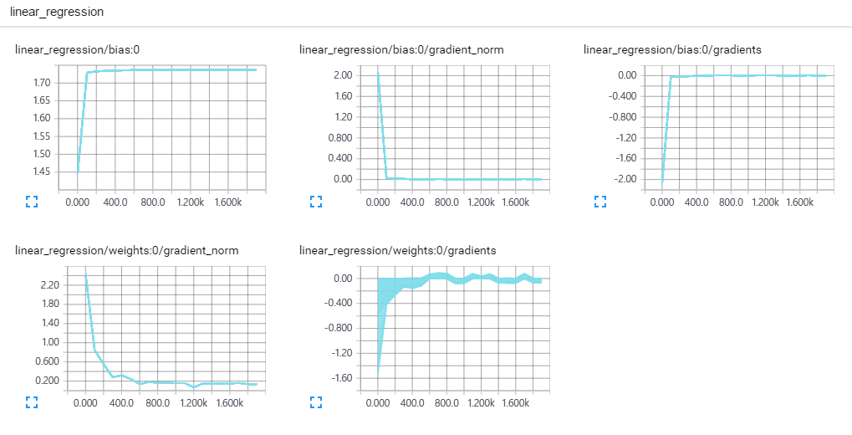
Tensorboard: Histogram

Slide 63
Contents
Overview of TensorFlow
Recurrent Neural Networks (RNN)
RNN Implementation
Case studies
Case study #1: MNIST using RNN
Case study #2: sine function
Case study #3: electricity price forecasting
Conclusions
Q & A

Slide 64
Conclusion
LSTM and GRU
Data preparation
RNN source code in TensorFlow is simple, but required time for training is painful.

Slide 65
Contents
Overview of TensorFlow
Recurrent Neural Networks (RNN)
RNN Implementation
Case studies
Case study #1: MNIST using RNN
Case study #2: sine function
Case study #3: electricity price forecasting
Conclusions
Q&A

Slide 66


Q&A
감사합니다.
전태균, PhD
Senior Researcher, R&D Center. SATREC INITIATIVE
Contact: tgjeon@satreci.com, taylor.taegyun.jeon@gmail.com
Github for this tutorial: https://github.com/tgjeon/TensorFlow-Tutorials-for-Time-Series

